Slide 1

BloodHound
Matthew Bialas & Sandra Markovic

Slide 2
What is BloodHound?
Open-source tool used for analyzing AD relationships & permissions
Displays potential attack paths in AD
Visually maps hidden AD relationships using graph theory
BloodHound is not a standalone executable
Created by:
Andy Robbins (@_wald0)
Rohan Vazarkar (@CptJesus)
Will Schroeder (@harmj0y)
Key Features:
Automates AD environment data collection
Generates visual AD environment graphs
Analyzes and identifies potential attack paths in AD
Utilizes Cypher query language for security searches
Creates reports and documentation for findings
Notes:
Sandra
The SharpHound data collector
The Neo4j backend (Graph Database)
The BloodHound GUI
The BloodHound query language

Slide 3
Why BloodHound?
**Our goal**
Expose vulnerabilities within the Active Directory environment.
Identify and visualize attack paths.
Privilege escalation opportunities & potential security risks.
**Why We Chose It**
Enjoyed Pentesting module.
Expand knowledge of Kali & other tools.
Metasploit, Mimikatz, DCSync
**Benefits & Opportunities**
Understanding AD Security
Hands-On Experience w/ CyberSec Tools
Real-World Application
Research & Analysis Opportunities
Strengthen Defensive Capabilities
Notes:
Matt:
We have not covered the BloodHound tool in this bootcamp, therefore, we thought it would be beneficial to research it in depth and learn more about it.
It is also used by both red and blue teams as an offensive and defensive tool
Provides a valuable learning experience

Slide 4
Advantages & Disadvantages
Pros:
Active Directory Assessment
Attack Path Visualization
Identify Escalation/Lateral Vulnerabilities
Open-Source and Active Community
Cons:
Steep Learning Curve for Beginners
Limited to AD Environments
Requires Administrative Access
Resource Intensive
Notes:
Matt:
Although BH is a powerful tool and is widely used by security professionals, it does have its pros and cons:
PROS:
AD Assessment: offers a deep dive into AD environments, allowing sec professionals to identify potential vulnerabilities, misconfig., and attack paths
Attack Path Visualization: provides graphs which help sec teams understand relationships between users, groups, and computers within the AD – making it easier to address sec issues
Identification of Privilege Escalation Paths: helps in identifying privilege escalation paths, allowing security teams to mitigate risks associated with excessive user privileges.
Real-Time Monitoring: It can be used for continuous monitoring of AD environments, helping detect and respond to potential threats in real-time
Open Source and Active Community: Being open-source, BH benefits from a large and active community of security professionals contributing to its development, ensuring that it stays updated with the latest techniques and methodologies.
CONS:
Steep Learning Curve: can have a steep learning curve for beginners due to its complex functionalities and the need to understand Active Directory structures and attack techniques.
Limited to Active Directory Environments: is specifically designed for Active Directory environments and may not be as useful for assessing other types of systems or networks.
Requires Administrative Access: To collect data effectively, BH requires administrative access to the Active Directory environment, which may raise security concerns and require proper authorization.
Potential for Misinterpretation: While BH provides valuable insights, there is a risk of misinterpreting the data or overlooking critical issues if not used correctly or if the user lacks sufficient understanding of Active Directory security principles.
Resource Intensive: Running BH scans and analyses can be resource-intensive, especially in large and complex Active Directory environments, requiring adequate computing resources and time for processing.

Slide 5
BloodHound vs. PingCastle
BloodHound:
Uses graph theory to reveal hidden relationships in AD environments.
Identifies high-value targets and potential attack paths helping security professionals anticipate and prevent breaches
PingCastle:
Designed to rapidly assess AD security based on risk assessment
Prioritizes efficiency over perfection
Offers visual reports
Audits large AD infrastructures
Provides comprehensive health check reports
Assesses risks, scores security, and offers improvement recommendations
Notes:
Sandra

Slide 6
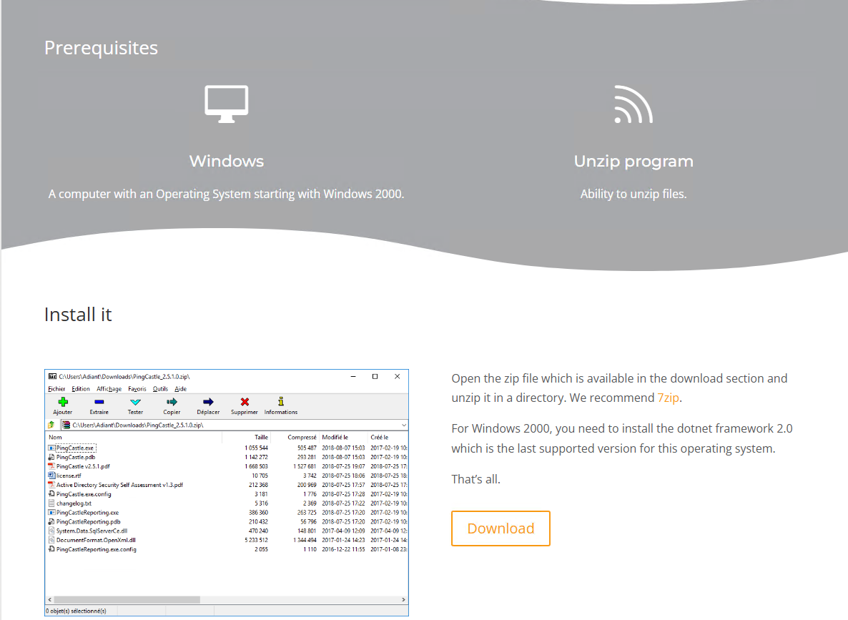
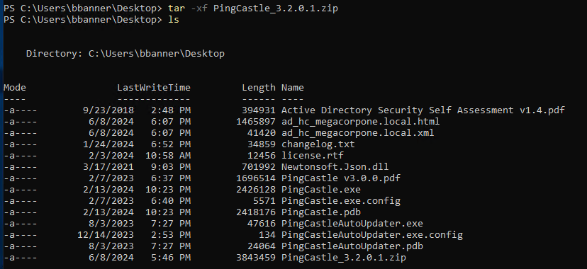
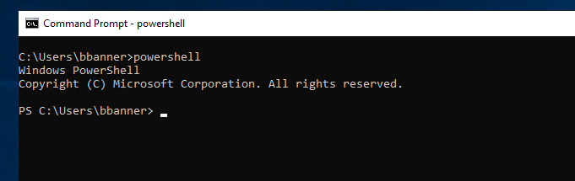

PingCastle Installation
1.
3.
2.
4.
Notes:
Sidenote: PingCastle launched under username BBanner since MegaCorpDomain already created

Slide 7
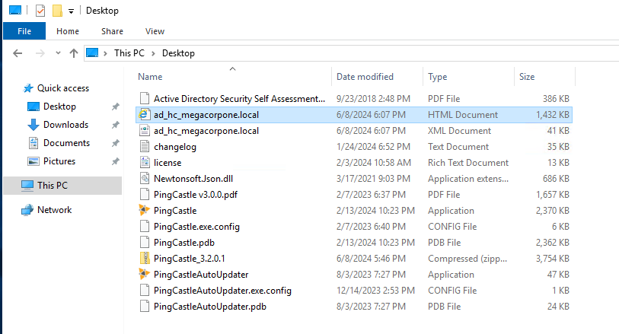
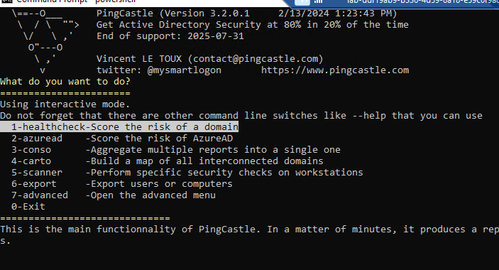
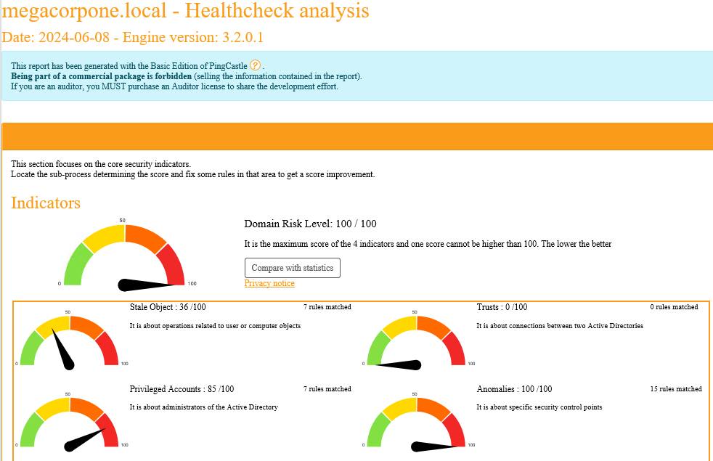
PingCastle, cont’d.
6.
5.
7.

Slide 8

PingCastle Demo
Notes:
Sandra’s Slide:
**For High Quality video - launch video via ‘Open in Drive’ - (click on the demo, then click on the arrow in top right corner)**

Slide 9

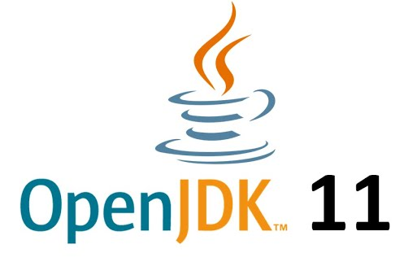


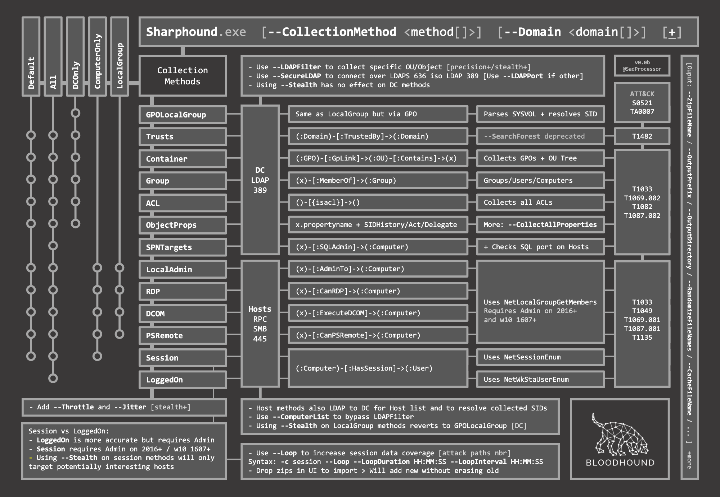
BloodHound Installation Process
Step 1. Connect to Kali Linux
Step 2. Download Java (OpenJDK 11 – Linux x64)
Step 3. Download Neo4j Graph Database
Step 4. Download BloodHound GUI
Step 5. Download SharpHound (Data Collector File)
Notes:
Sandra:
Since BloodHound does not come pre-installed on Kali, the following installation process took place:
Download Java (OpenJDK 11 – Linux x64): Downloaded from Microsoft onto the Kali VM
Download Neo4J: Downloaded from neo4j.com/deployment-center/#community > choose which version to download > Linux/Mac Executable
Once connected in Kali, leave program running in the background
Download the BloodHound GUI: Downloaded from GitHub/BloodHoundAD/BloodHound/releases > Linux x64 >
Once connected in Kali, leave program running in the background
Download SharpHound (data collector): downloaded from GitHub on to Kali VM

Slide 10
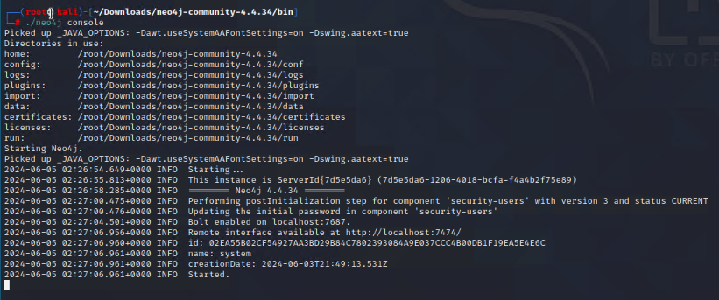
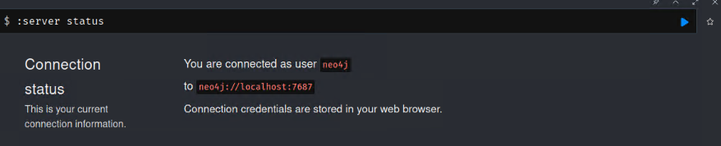
Pathway to BloodHound
Starting neo4j
Notes:
Matt:

Slide 11

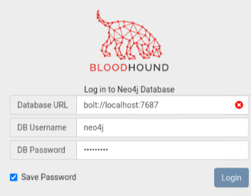
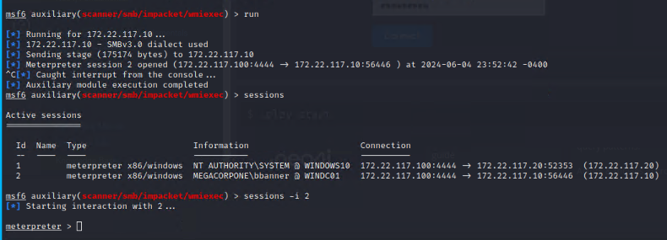
Pathway to BloodHound
Starting BloodHound
Metasploit Meterpreter Shell
Notes:
Matt

Slide 12
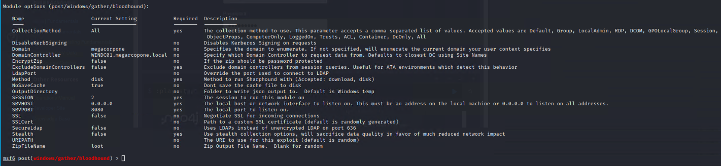
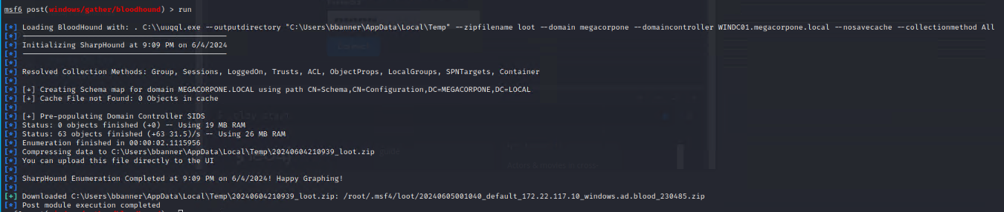
Pathway to BloodHound
Metasploit BloodHound Module
Running SharpHound
Notes:
Matt

Slide 13
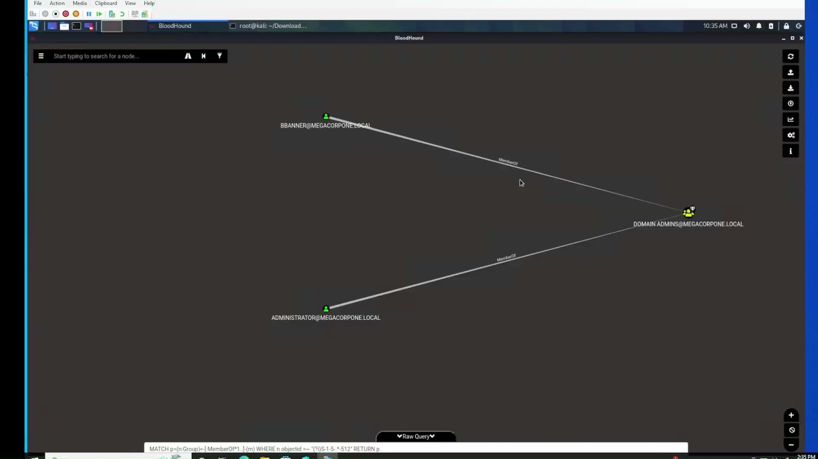
BloodHound Demonstration
Notes:
Matt

Slide 14
BloodHound Demonstration Summary
BloodHound is a powerful & convenient tool for evaluating Active Directory environments.
AD objects are easily visualized with a Red Team mindset in pre-built queries.
Escalate Privilege to MegaCorpOne Administrators Group
Diverse options of attack paths & methods.
OpSec Considerations helpful from a Blue Team perspective.
Strengthening Kerberos Accounts
ENHANCEMENT SUGGESTIONS
Visuals highlighting weak spots.
Consistent real-time data.
Notes:
Matt

Slide 15
Mitigations/AD Security Best Practices
Implement strong password policies & enforce MFA
Regular Patching
Implement least privilege
Monitor and Audit
Tiered administrative model to control access rights
Disable unnecessary services and protocols
Use BloodHound for defensive purposes
Periodic Red Team Exercises
Plan for Active Directory recovery
Regular Security Awareness Training
Implement Endpoint Protection (detect & block malicious activities)
Stay informed & updated
Notes:
Sandra
Regular Patching: (helps organizations mitigate known vulnerabilities & stay ahead of potential threats & reduce risk of security/data breaches)
Implement least privilege: (limit # of users & system privilege to only what is necessary for their roles)
Monitor and Audit: (logging & monitoring solutions for suspicious activity)
Periodic Red Team Exercises: (conduct real-world attack scenarios & identify weaknesses in your defenses)
Implement Endpoint Protection: (detect & block malicious activities on endpoints)

Slide 16
Challenges Encountered
VM Disc Space
Compatibility
Newer/Older Versions
Integration with Existing Tools
Issues installing packages with ‘apt-get’ in Kali
Failure to launch BloodHound with other open-source tools
Failure to launch SharpHound/BloodHound after manually creating an AD
Notes:
Sandra & Matt Slide
Evil-WinRM: open-source, command-line-based tool that provides remote shell access to Windows machines over WinRm (Windows Remote Mgmt.).
Failure to launch BH & SH after manually creating an AD: connection issues within Windows
Sandra:
Importance of having the correct version downloaded: Trying to find which version is compatible with what (i.e. neo4j & BloodHound).
Newer version of neo4j was not compatible with the BH version I had, so had to revert to an older version
Overall, I learned that a certain process or approach may work for someone else, but it may not work for you; therefore, it is best not to rely solely on research of others but to also conduct additional and in-depth research of your own before starting anything or making any decisions.

Slide 17
References:
ChatGPT - Personal Communications: May & June 2024
bluegoatcyber.com - Top Active Directory Security Tools
stationx.net - How To Use Bloodhound Active Directory
hacktricks.xyz - Windows Hardening
pingcastle.com
reddit.com - Active Directory Analyzer
semperis.com - Active Directory Security Best Practices
sans.org - Sniffing Out Path Through Windows Domains
bloodhoundenterprise.io

Slide 18


Slide 19


